Slide 1
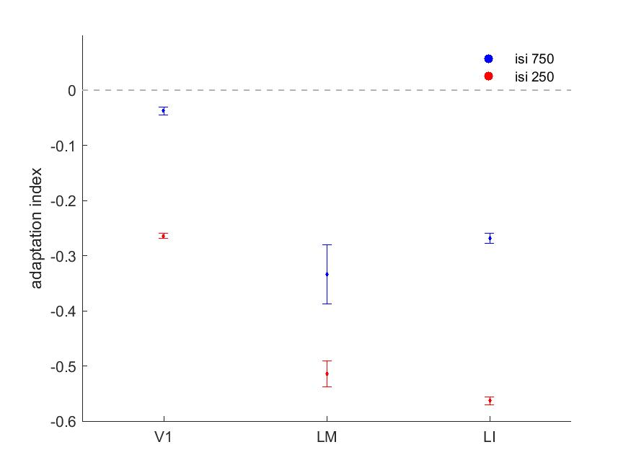
Adaptation index across areas

Slide 2
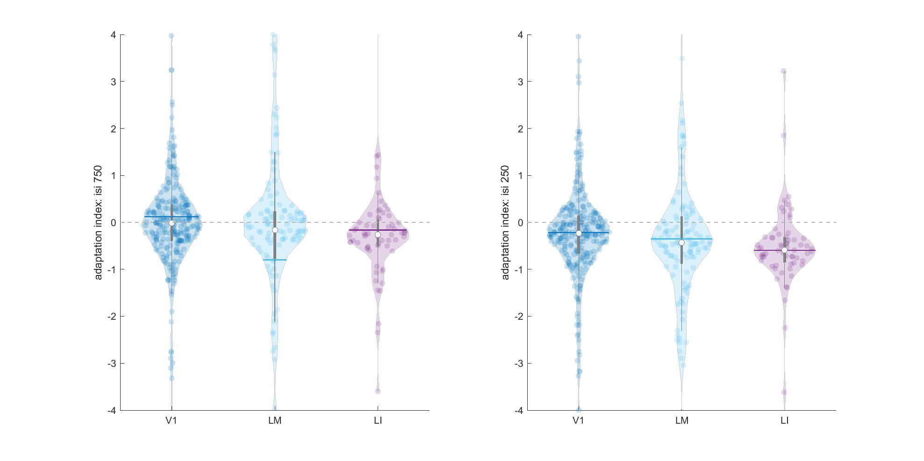
Adaptation index across areas

Slide 3
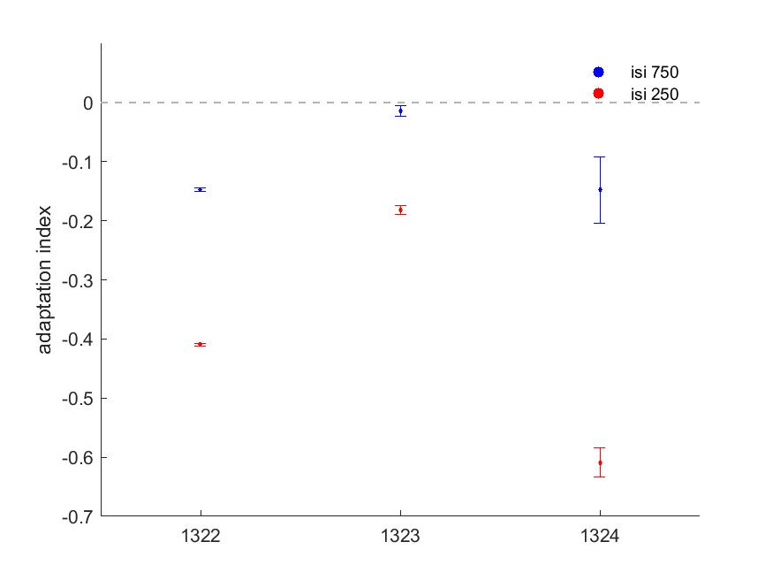
Adaptation index across mice

Slide 4
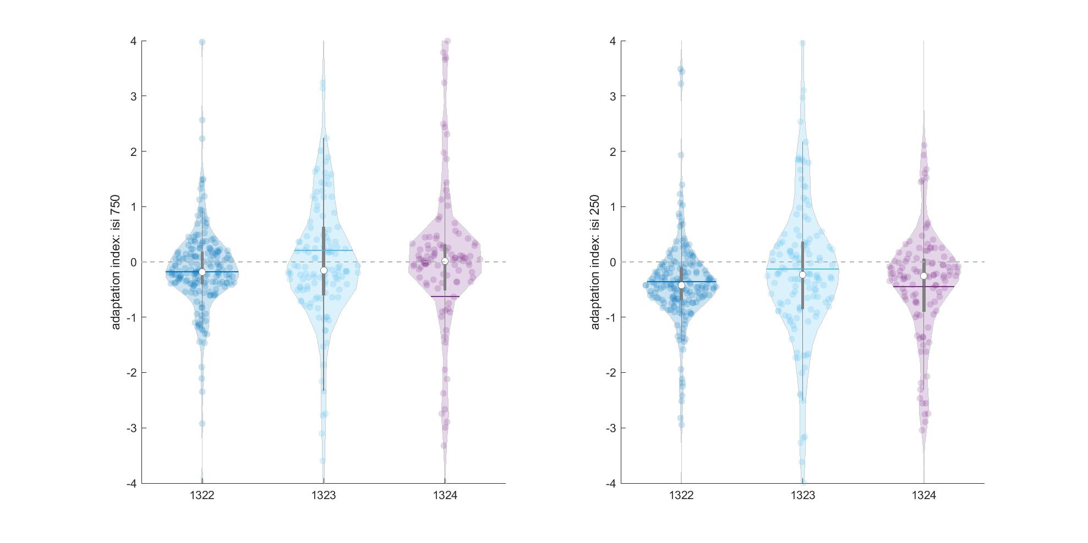
Adaptation index across mice

Slide 5
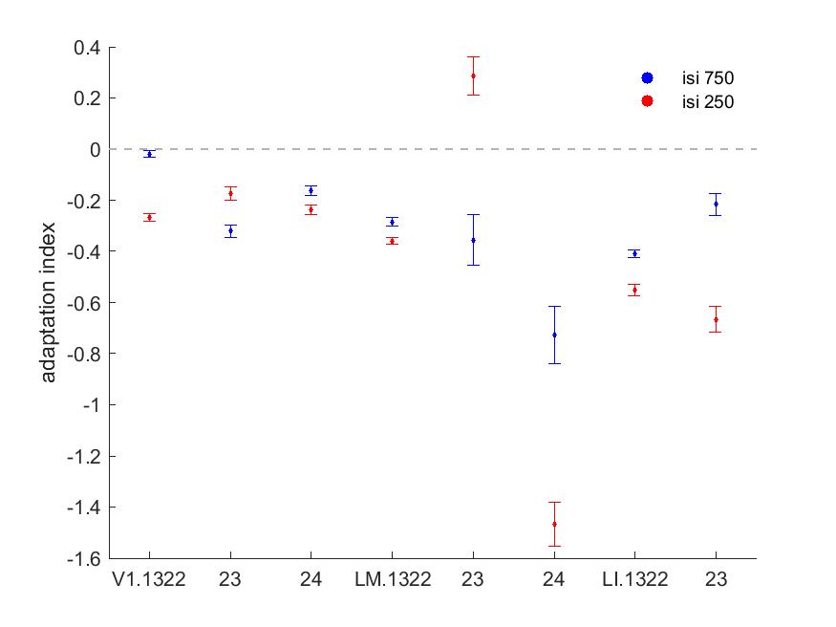
Adaptation index across areas list mice

Slide 6
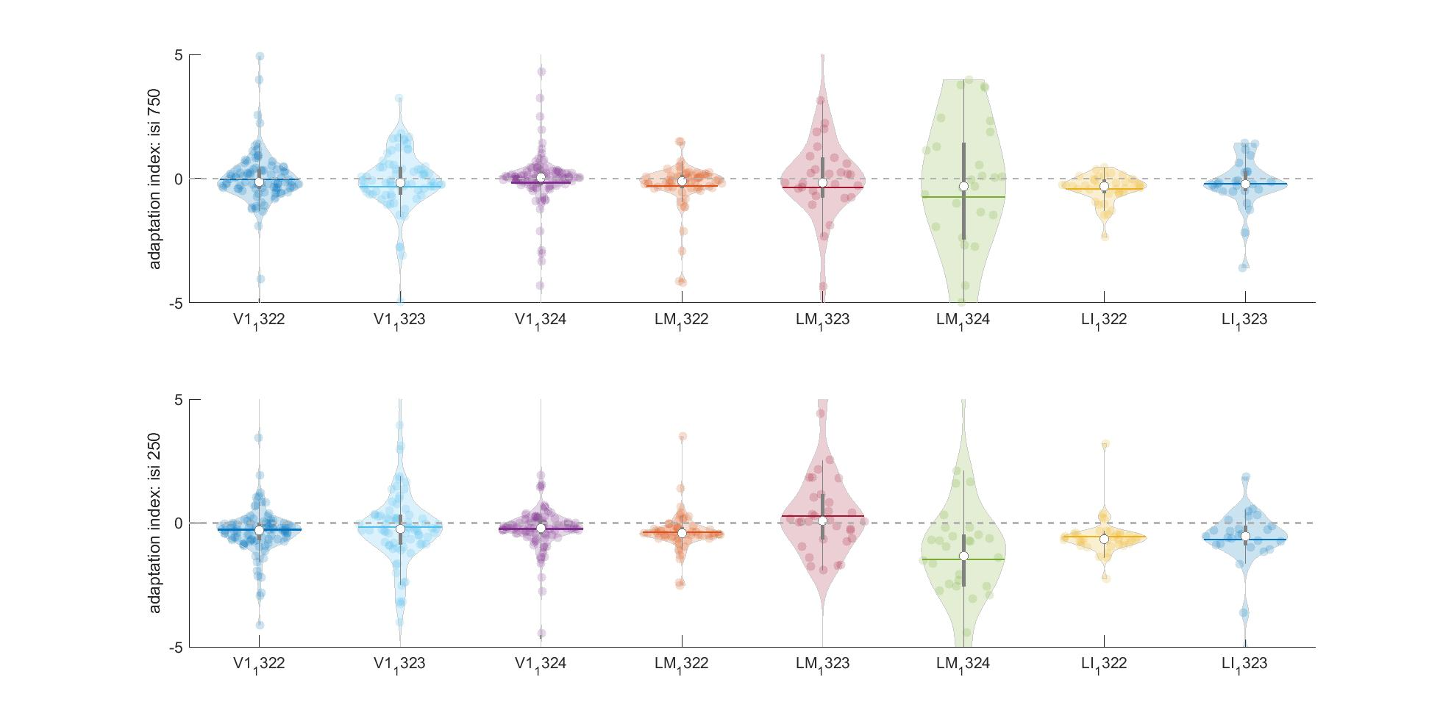
Adaptation index across areas list mice

